Slide 1
Module V- Programming Models and Advances
Dr. Madhukrishna Priyadarsini
Assistant Professor
NIT Trichy

Slide 2
Outline:
Programming Models:
MapReduce
Apache Spark
Tensor Flow
Intercloud Architecture
Advances:
Mobile Cloud Computing
Edge Computing
Fog Computing

Slide 3
MapReduce
MapReduce is a programming model developed by Google
Objective:
Implement large scale search
Text processing on massively scalable web data stored using big table and GFS distributed file systems
Designed for processing and generating large volumes of data via massively parallel computations, utilizing tens of thousands of processors at a time.
Fault tolerant: ensure progress of computation even if processors and networks fail
Example:
Hadoop: An open source implementation of MapReduce (developed at Yahoo!)
Available on pre-packaged AMIs on Amazon EC2 cloud platform

Slide 4
Parallel computing
Different models of parallel computing
Nature and evolution of multi-processor computer architecture
Shared-memory model
Assumes that any processor can access any memory location
Unequal latency
Distributed memory model
Each processor can access only its own memory and communicates with other processors using message passing
Parallel computing
Developed for computing intensive scientific tasks
Later found application in the database arena
Shared memory
Shared disk
Shared nothing

Slide 5
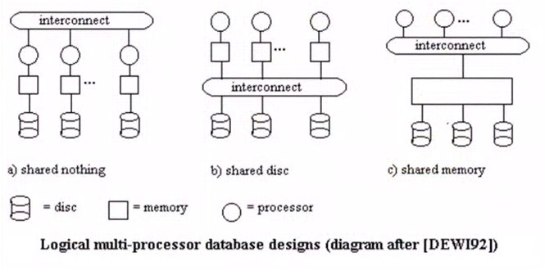
Parallel database architecture

Slide 6
Parallel database architecture contd…
Shared memory
Suitable for servers with multiple CPUs
Memory address space is shared and managed by a symmetric multi-processing (SMP) operating system
SMP:
Schedules processes in parallel exploiting all the processors
Shared nothing
Cluster of independent servers each with its own disk space
Connected by a network
Shared disk
Hybrid architecture
Independent server cluster share storage through high speed network storage viz, NAS or SAN
Clusters are connected to storage via: standard ethernet or faster Fiber channel or infiband connections

Slide 7
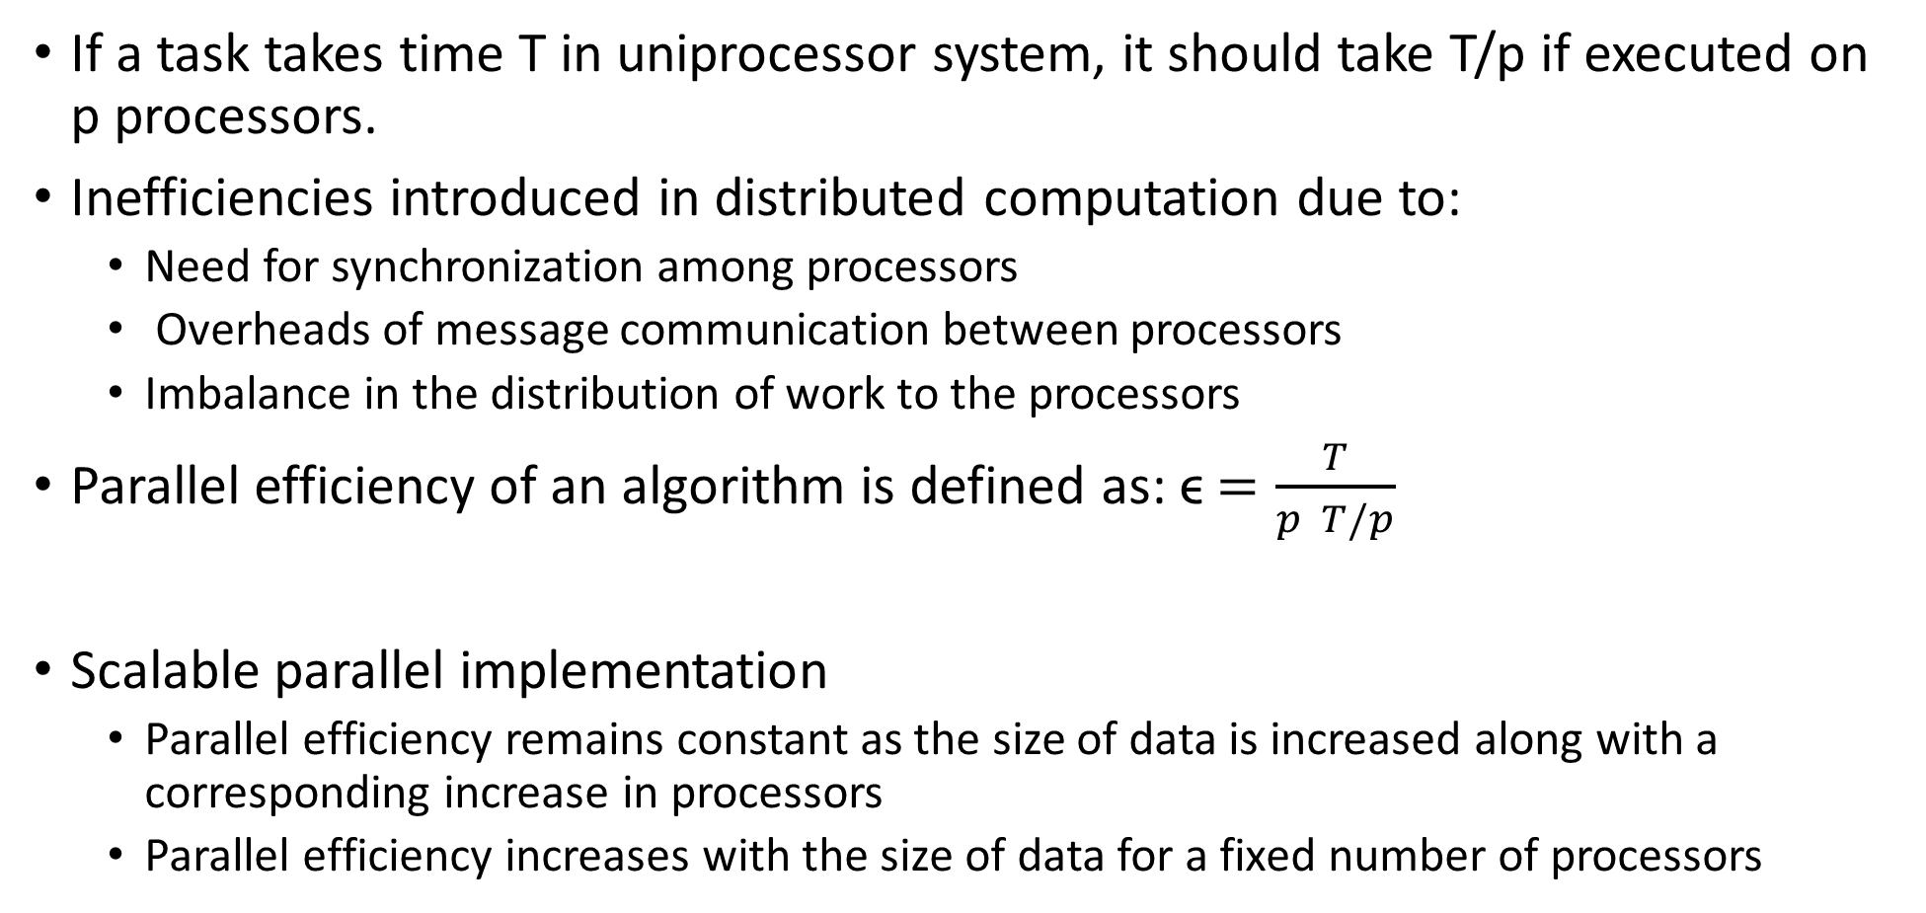
Parallel Efficiency
If a task takes time T in uniprocessor system, it should take T/p if executed on p processors.
Inefficiencies introduced in distributed computation due to:
Need for synchronization among processors
Overheads of message communication between processors
Imbalance in the distribution of work to the processors
Parallel efficiency of an algorithm is defined as: ϵ$=\frac{T}{p T/p}$
Scalable parallel implementation
Parallel efficiency remains constant as the size of data is increased along with a corresponding increase in processors
Parallel efficiency increases with the size of data for a fixed number of processors

Slide 8
MapReduce Model
It is a parallel programming abstraction
Used by many different parallel applications which carry out large scale computation involving thousands of processors
Leverages a common underlying fault-tolerant implementation
MapReduce has two phases:
Map operation
Reduce operation
A configurable number of M ‘mapper’ processors ad R ‘reducer’ processors are assigned to work on the problem
Computation is coordinated by a single master process

Slide 9
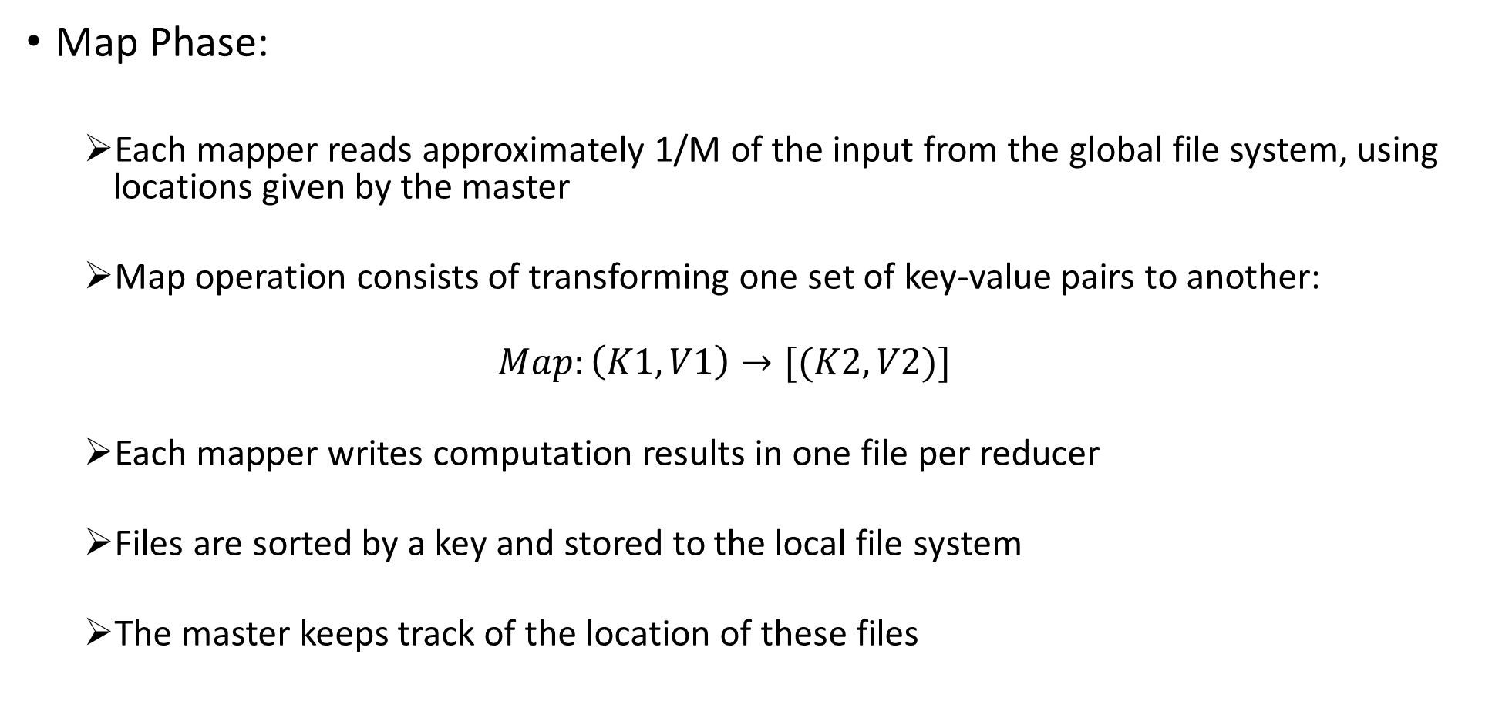
Map Phase:
Each mapper reads approximately 1/M of the input from the global file system, using locations given by the master
Map operation consists of transforming one set of key-value pairs to another:
$$Map:\left(K1,V1\right)→[(K2,V2)]$$
Each mapper writes computation results in one file per reducer
Files are sorted by a key and stored to the local file system
The master keeps track of the location of these files

Slide 10
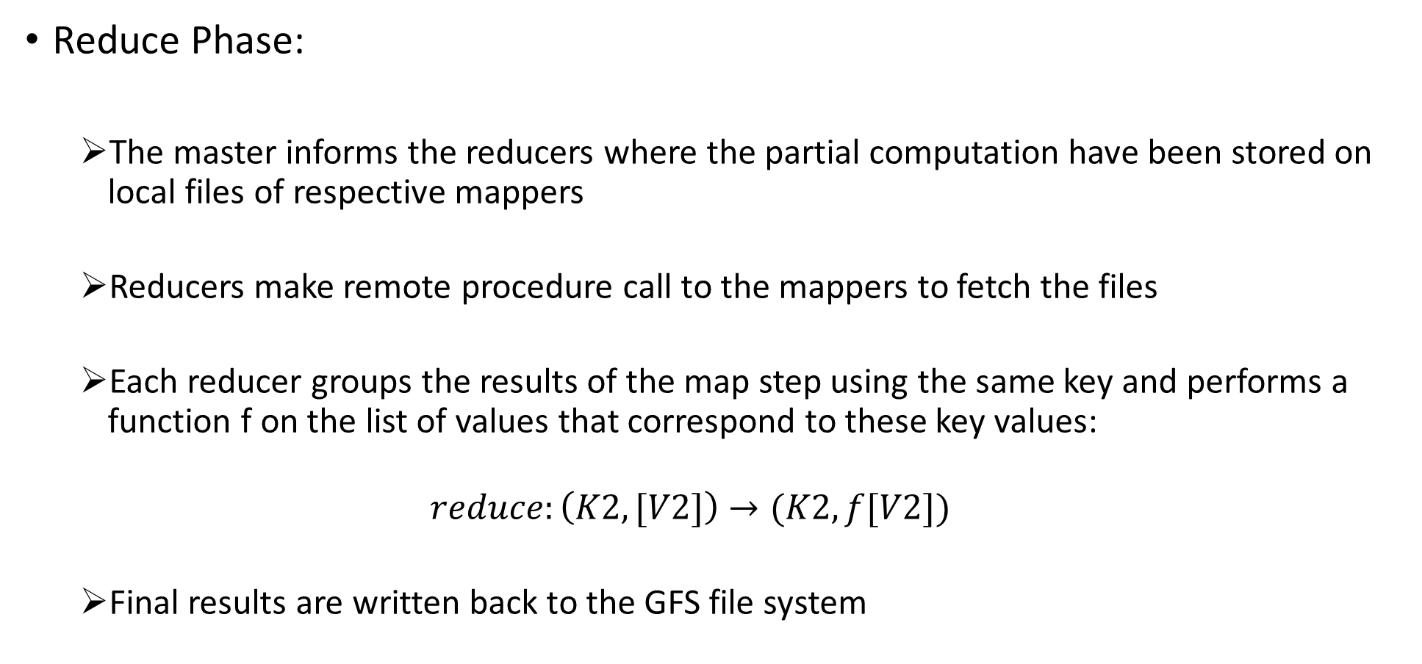
Reduce Phase:
The master informs the reducers where the partial computation have been stored on local files of respective mappers
Reducers make remote procedure call to the mappers to fetch the files
Each reducer groups the results of the map step using the same key and performs a function f on the list of values that correspond to these key values:
$$reduce:\left(K2,[V2]\right)→(K2,f[V2])$$
Final results are written back to the GFS file system

Slide 11
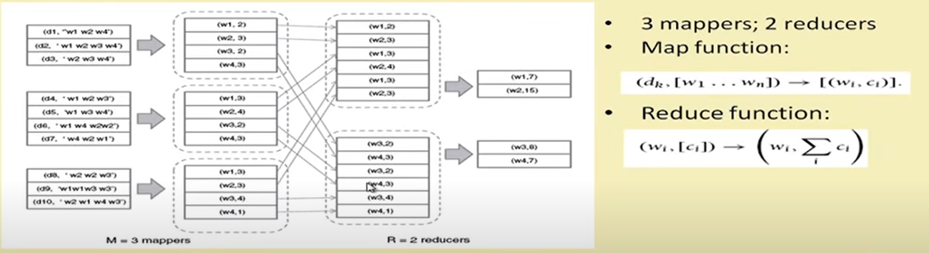
MapReduce Example

Slide 12
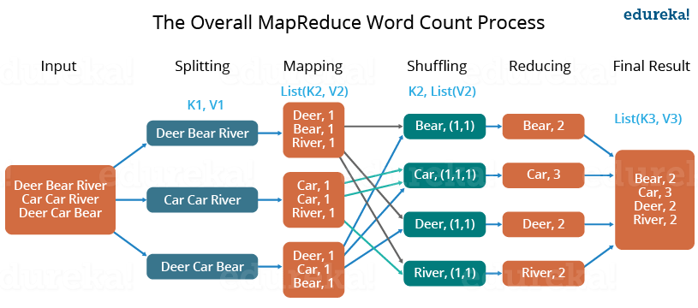

Slide 13
MapReduce: Fault Tolerance
Heartbeat communication:
Updates are exchanged regarding the status of the task assigned to workers
Communication exists, but no progress: master duplicates those tasks and assigns to processors who have already completed
If a mapper fails, the master reassigns the key-range designated to it to another working node for re-execution
Re-execution is required as the partial computations are written into local files, rather than GFS file system
If a reducer fails, only the remaining tasks are reassigned to another node, since the completed tasks are already written back into GFS

Slide 14
MapReduce Efficiency
General computation task on a volume of data D
Takes wD time on an uniprocessor (time to read data from disk + performing computation + time to write back to disk)
Time to read/write one word from/to disk= c
Now, the computational task is decomposed into map and reduce stages as follows:
Map stage:
Mapping time= c_{m}D
Data produced as output= σD
Reduce stage:
Reducing time= c_{r}σD
Data produced as output= σμD

Slide 15
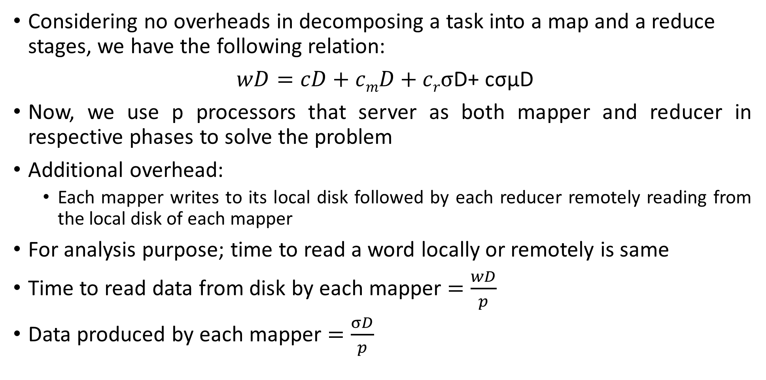
Considering no overheads in decomposing a task into a map and a reduce stages, we have the following relation:
$wD=cD+cmD+crσ$D+ cσμD
Now, we use p processors that server as both mapper and reducer in respective phases to solve the problem
Additional overhead:
Each mapper writes to its local disk followed by each reducer remotely reading from the local disk of each mapper
For analysis purpose; time to read a word locally or remotely is same
Time to read data from disk by each mapper $=\frac{wD}{p}$
Data produced by each mapper $=\frac{σD}{p}$

Slide 16
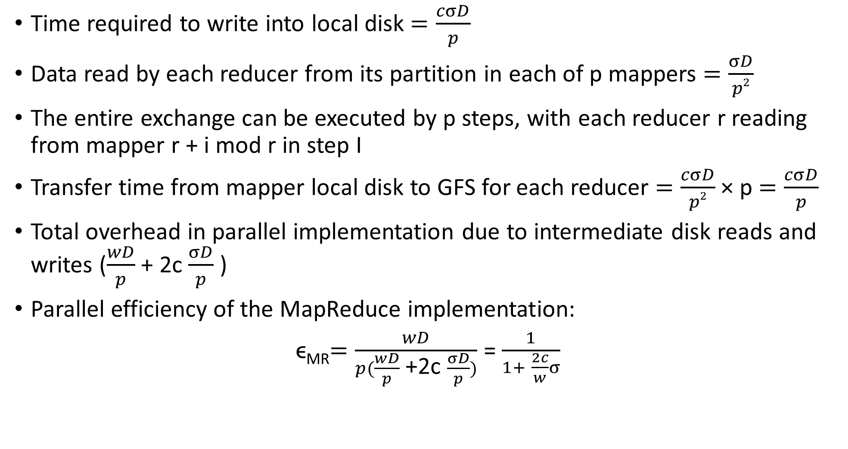
Time required to write into local disk $=\frac{cσD}{p}$
Data read by each reducer from its partition in each of p mappers $=\frac{σD}{p2}$
The entire exchange can be executed by p steps, with each reducer r reading from mapper r + i mod r in step I
Transfer time from mapper local disk to GFS for each reducer $=\frac{cσD}{p2}$ × p $=\frac{cσD}{p}$
Total overhead in parallel implementation due to intermediate disk reads and writes ($\frac{wD}{p}$ + 2c $\frac{σD}{p}$ )
Parallel efficiency of the MapReduce implementation:
ϵ_{MR}$=\frac{wD}{p(\frac{wD}{p} \text{+}\text{2}\text{c} \frac{σD}{p})}$ = $\frac{1}{1+ \frac{2c}{w}σ}$

Slide 17
MapReduce: Applications
Indexing a large collection of documents
Important aspect in web search as well as handling structured data
The map task consists of emitting a word-document/record-id pair for each word: (d_{k},[w₁,…,w_{n}]) -> [(w_{i},d_{k})]
The reduce step groups the pairs by word and creates an index entry for each word: [(w_{i},d_{k})] -> (w_{i}, [d_{i1},…,d_{im}])
Relational operations using MapReduce
Execute SQL statements (relational joins/group by) on large datasets
Advantages over parallel database
Large scale
Fault-tolerance

Slide 18
Problem-1: In a MapReduce framework consider the HDFS block size is 64MB. We have 3 files of size 64Kb, 65Mb, and 127Mb. How many blocks will be created by Hadoop framework?

Slide 19
Problem-2: Write the pseudo codes (for map and reduce functions) for calculating the average of a set of integers in MapReduce. Suppose A = (10,20,30,40,50) is a set of integers. Show the map and reduce outputs?

Slide 20
Problem-3: Compute total and average salary of organization XYZ and group by gender (male or female) using MapReduce. The input is as follows: Name, Gender, Salary John, M, 10k Martha, F, 15k ……..

Slide 21
Hadoop
Hadoop is an open source framework that allows us to store and process large datasets in parallel and distributed manner.
Two main components: HDFS and MapReduce.
Hadoop Distributed file system (HDFS) is the primary data storage system used by Hadoop applications.
MapReduce is the processing unit of Hadoop.

Slide 22
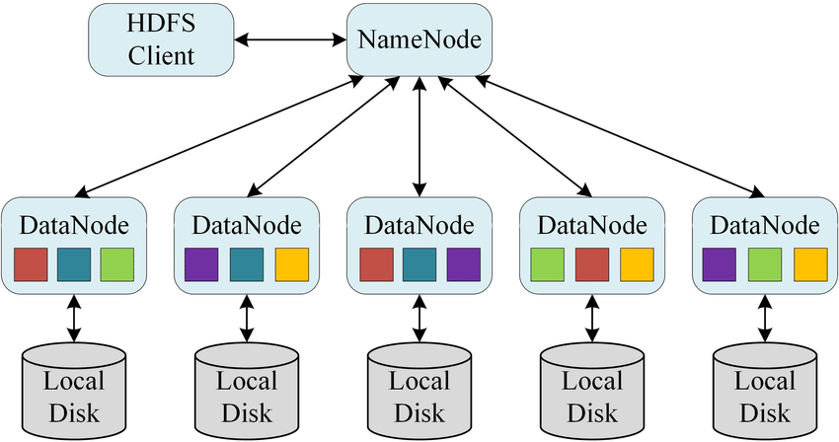
Hadoop Distributed File System (HDFS)

Slide 23
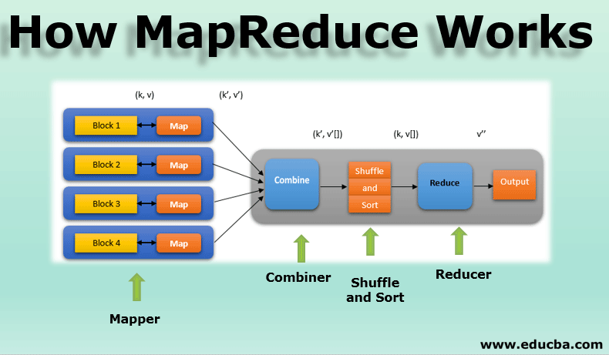
MapReduce

Slide 24
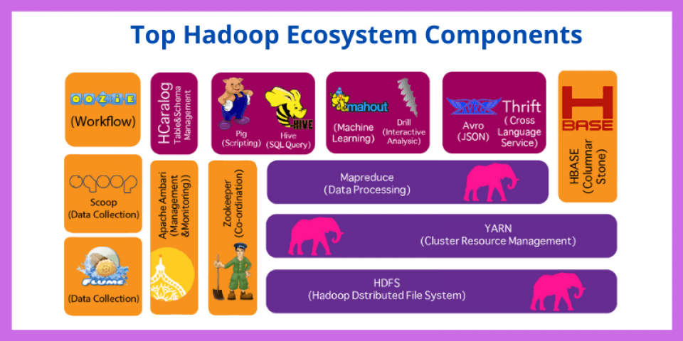
Hadoop Eco System

Slide 25
Apache Spark
Framework of Spark
Resilient Distributed Datasets (RDDs)
Applications: PageRank, GrapghX
Apache Spark is a big data analytics framework that was designed by University of California in 2012. Since, then it has gained a lot of attraction both in academia and industry.
It is an another system for big data analytics.

Slide 26
Need of Spark
Is not MapReduce good enough?
Simplifies batch processing on large commodity clusters.
MapReduce can be expensive for some applications such as;
Iterative
Interactive
Lacks efficient data sharing
Specialized frameworks did evolve for different programming models
Bulk synchronous processing (Pregel)
Iterative MapReduce (Hadoop)

Slide 27
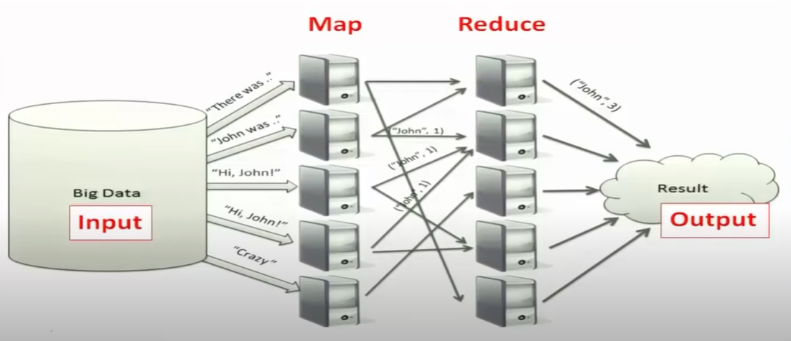

Slide 28
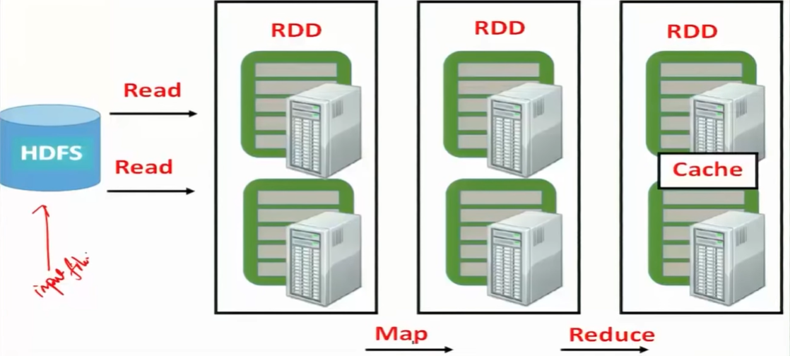
Solution: Resilient Distributed Datasets (RDDs)
Resilient Distributed Data Sets (RDDs):
Immutable, partitioned collection of records
Built through coarse grained transformations (map, join,…..)
Can be cached for efficient reuse.

Slide 29
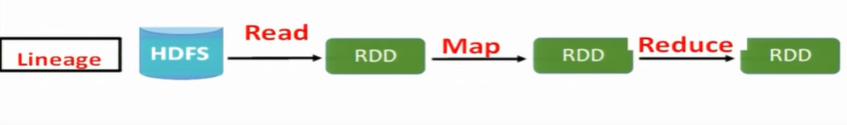
Fault Recovery?
Lineage!
Log the coarse grained operation applied to a partitioned dataset
Simply recompute the lost partition if failure occurs
No cost if no failure
The RDDs track the graph of transformations that built them (their lineage) to rebuild lost data

Slide 30
What we can do with Spark?
RDD Operations:
Transformations e.g., filter, join, map, group by,…..
Actions e.g., count, print,…..
Control:
Partition: Spark also gives you control over how you can partition your RDDs
Persistence: Allows you to choose whether you want to persist RDD on to disk or not

Slide 31
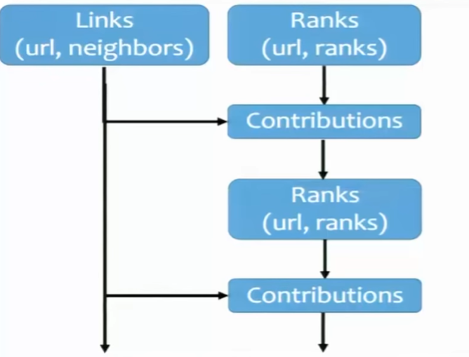
Partitioning: PageRank
Join takes place repeatedly
Good partitioning reduces shuffles

Slide 32
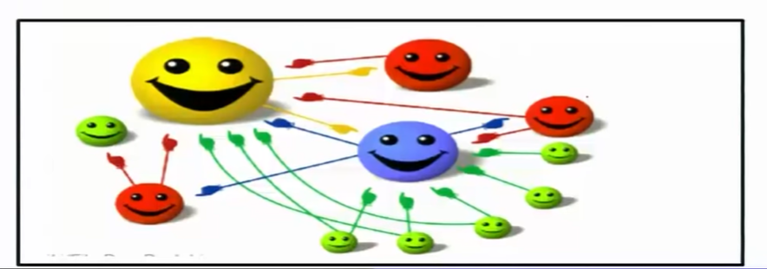
Example: PageRank
Give page ranks (scores) based on links to them
Links from many pages High rank
Links from high rank pages High rank

Slide 33
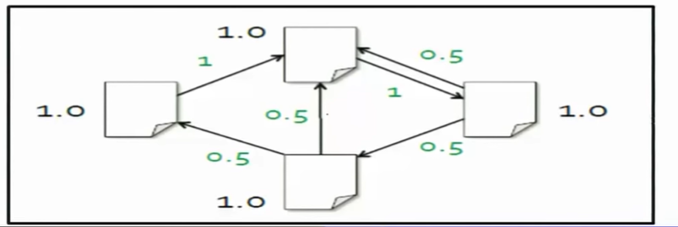
Algorithm
Step-1: Start each page at a rank of 1
Step-2: On each iteration, have page p contribute rank_{p} / |neighbors_{p}| to its neighbors
Step-3: Set each page’s rank to 0.15+0.85*contributions

Slide 34
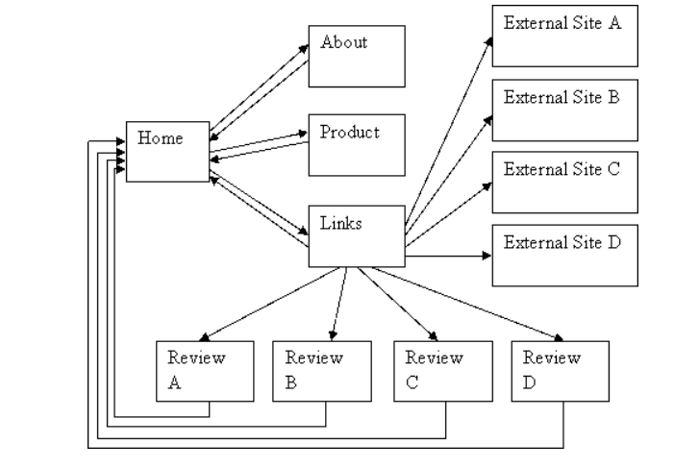
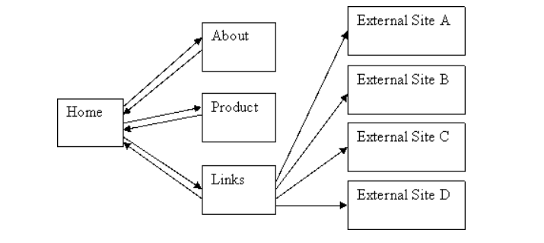
Q- Calculate the page ranks of each pages shown below?

Slide 35
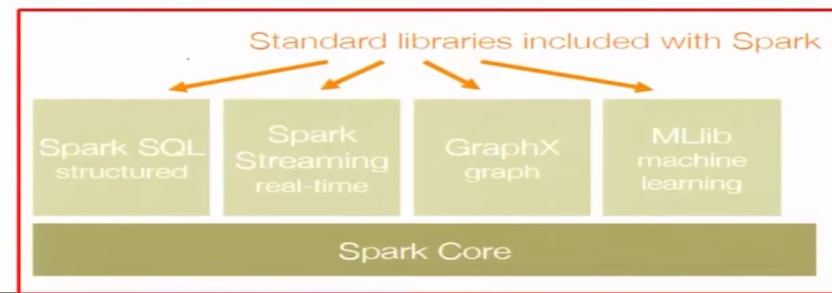
Generality
RDDs allow unification of different programming models
Stream processing
Graph processing
Machine learning

Slide 36
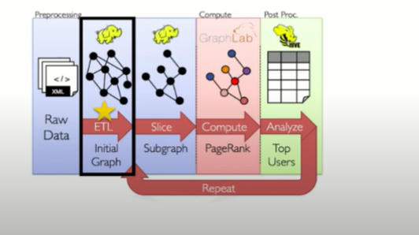
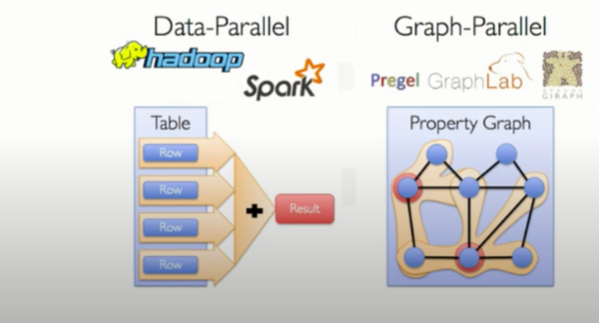
GraphX
GrpahX is the Apache Spark component for graph parallel computations, built upon a branch of mathematics called graph theory. It is a distributed graph processing framework that sits on top of spark core.

Slide 37
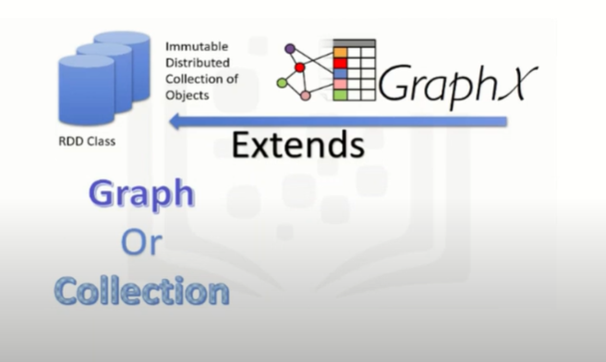
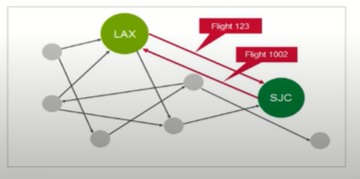
GraphX Property graph:
GraphX extends the Spark RDD with a Resilient Distributed Property Graph.
The property graph is a directed multigraph which can have multiple edges in parallel. Every edge and vertex has user-defined properties associated with it. The parallel edges allow multiple relationships between the same vertices.
Basic Graph Properties:
Relationship between objects
Vertices and edges
Directed graph
Regular graph

Slide 38
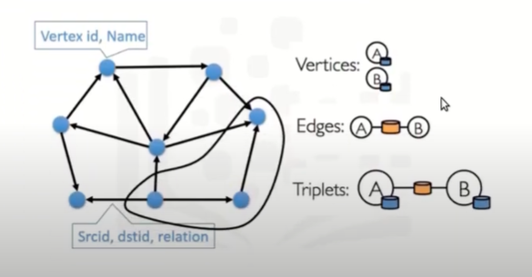
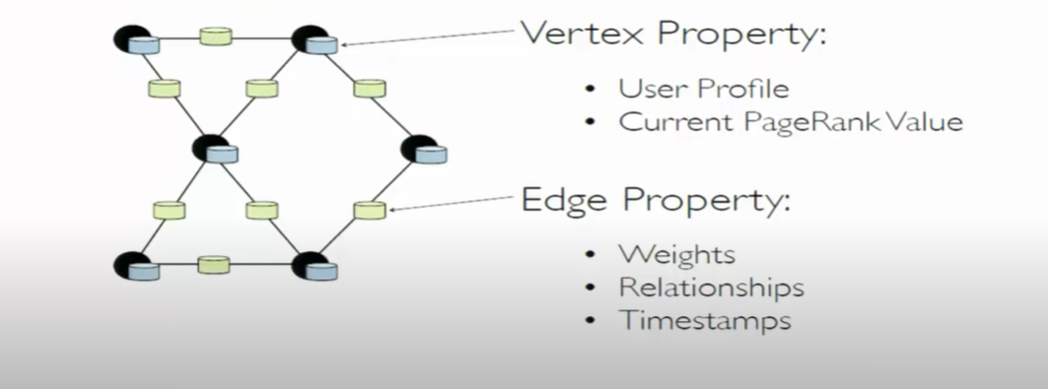
Components of GraphX (Property Graph)

Slide 39
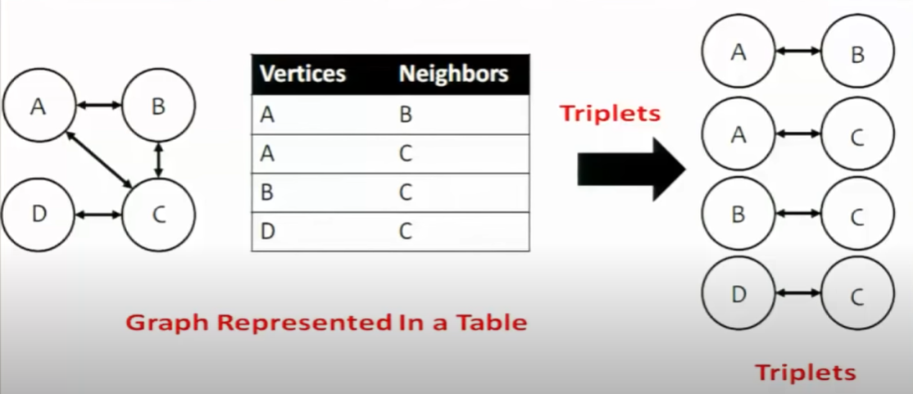
Gather-Apply-Scatter-on GraphX

Slide 40
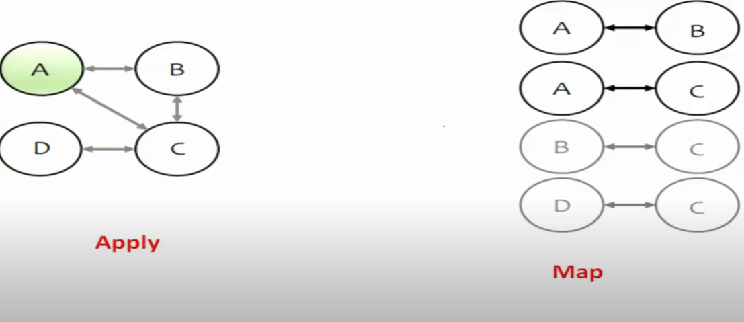
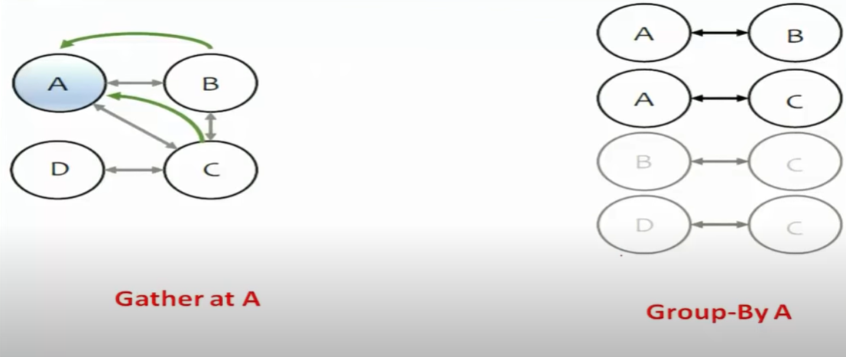

Slide 41
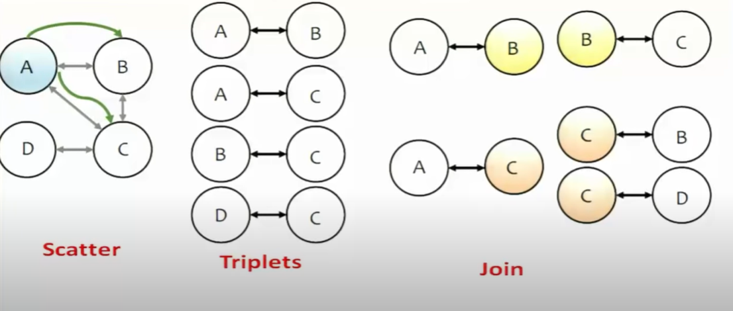

Slide 42
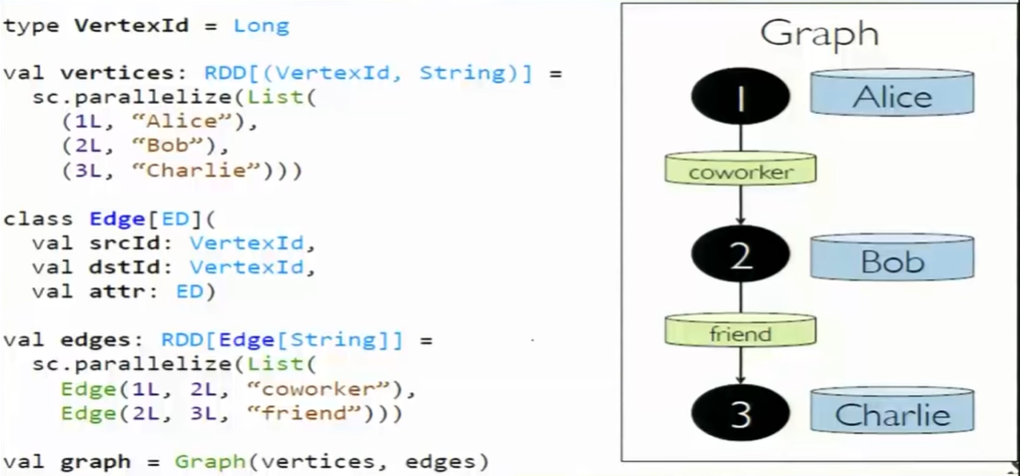
Creating a Graph (Scala)
Installation an getting started with Scala: https://docs.scala-lang.org/getting-started/index.html

Slide 43
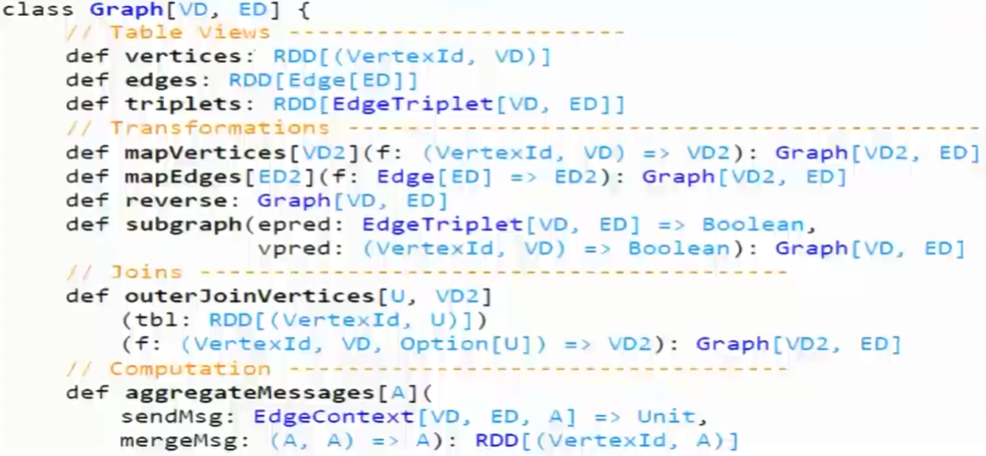

Slide 44
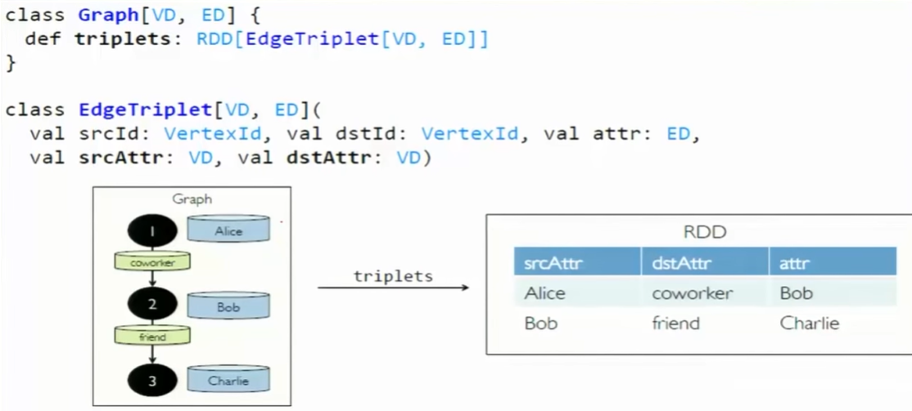
The Triplet View

Slide 45
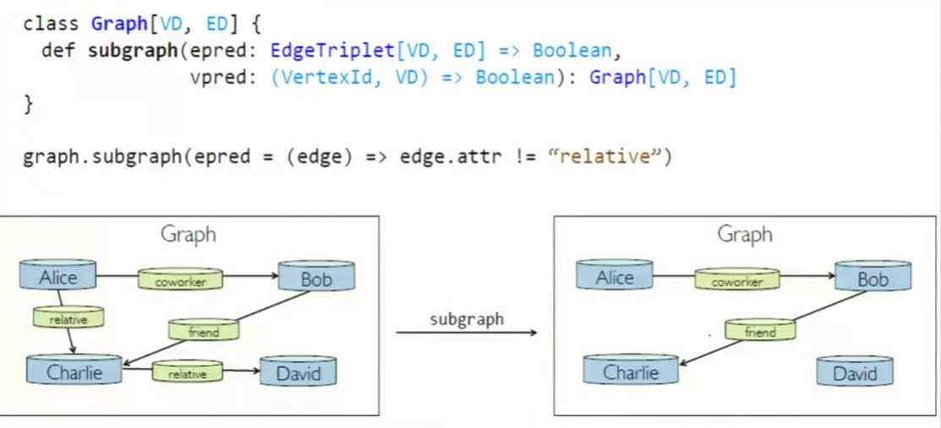
The Subgraph Transformation

Slide 46
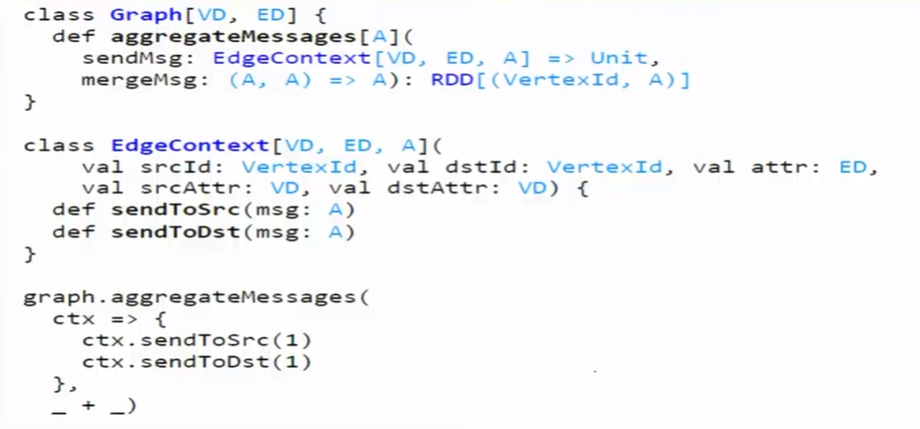
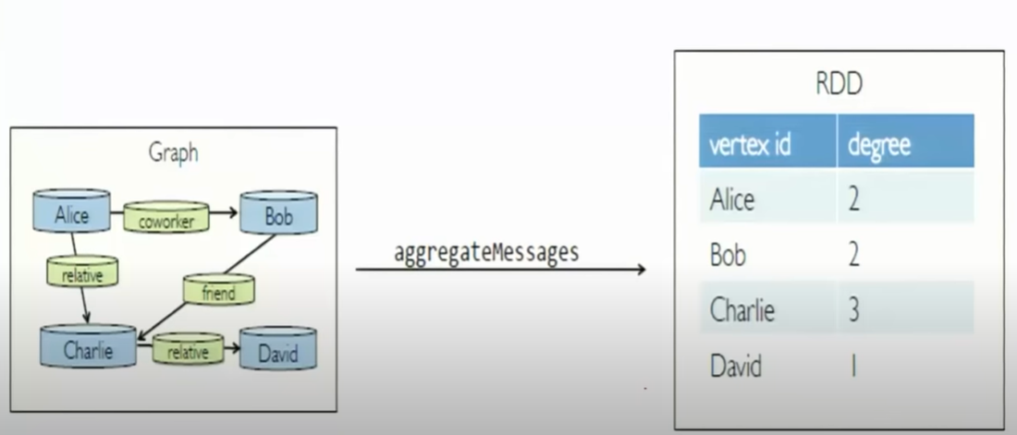
Computation with aggregated messages

Slide 47
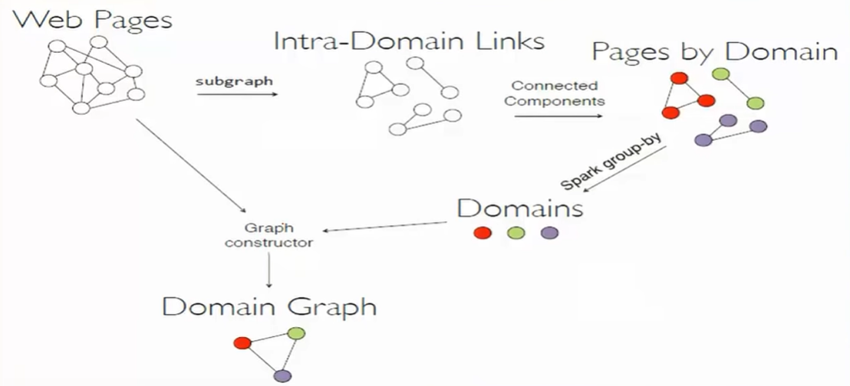
Example: Graph Coarsening

Slide 48
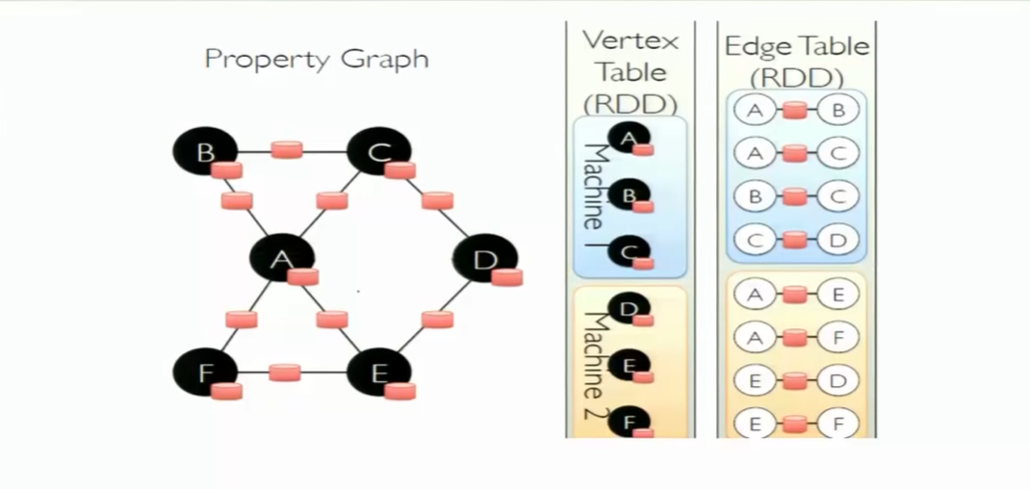
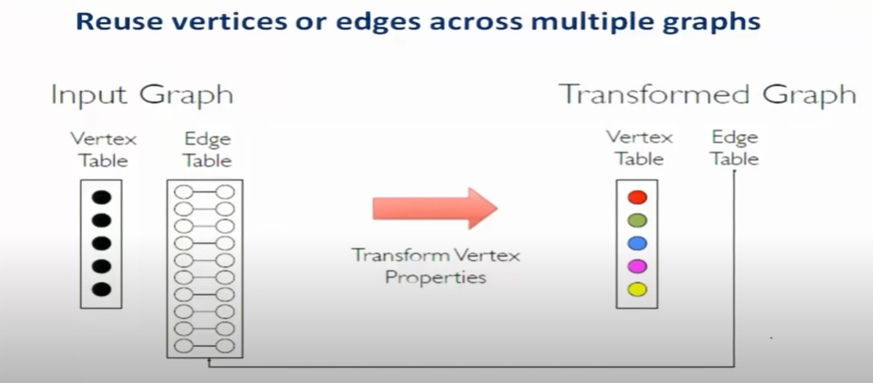
How GraphX works?
Simple operations
Storing graphs as tables

Slide 49
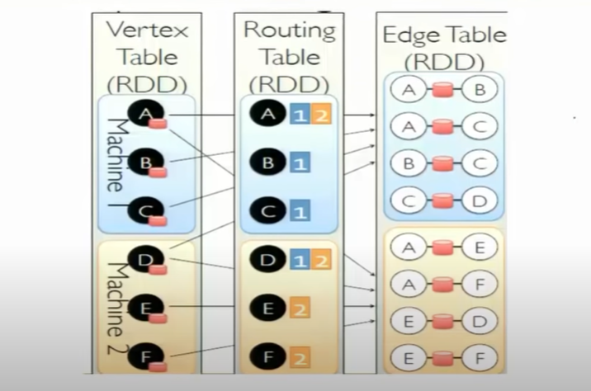
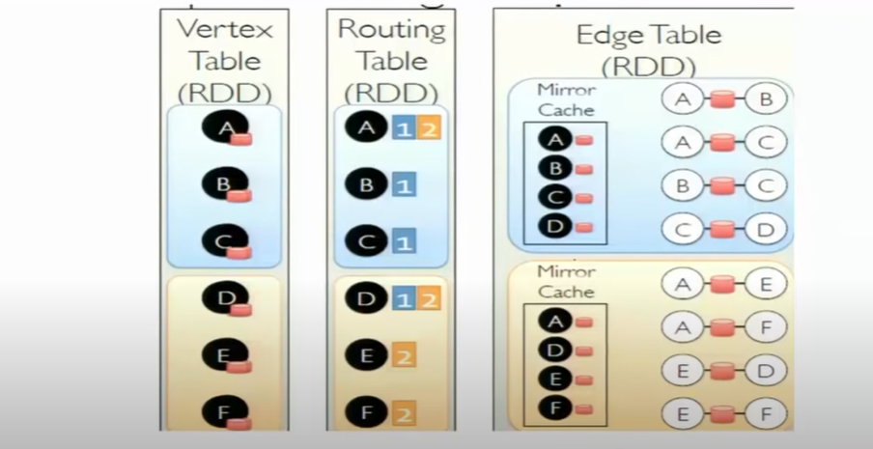
Implementing the Triplets

Slide 50
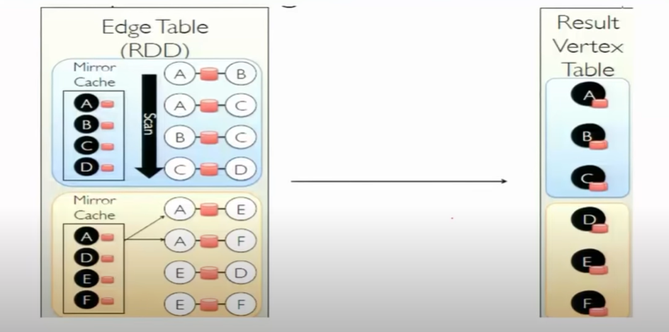
Implementing Aggregate messages

Slide 51
Example: Analyze 3 flights, for each flight we have the following information:
Use GraphX to find the routes having > 1000 miles distance?
Originating Airport | Destination Airport | Distance
A | B | 1800 miles
B | C | 800 miles
C | A | 1400 miles

Slide 52
Other Spark Applications
Twitter Spam Classification
EM algorithm for traffic prediction
K-means clustering
Alternating Last-squares Matrix factorization
In Memory OLAP Aggregation on Hive Data
SQL on Spark

Slide 53
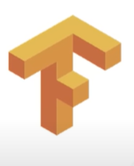
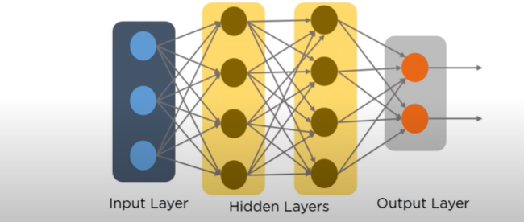
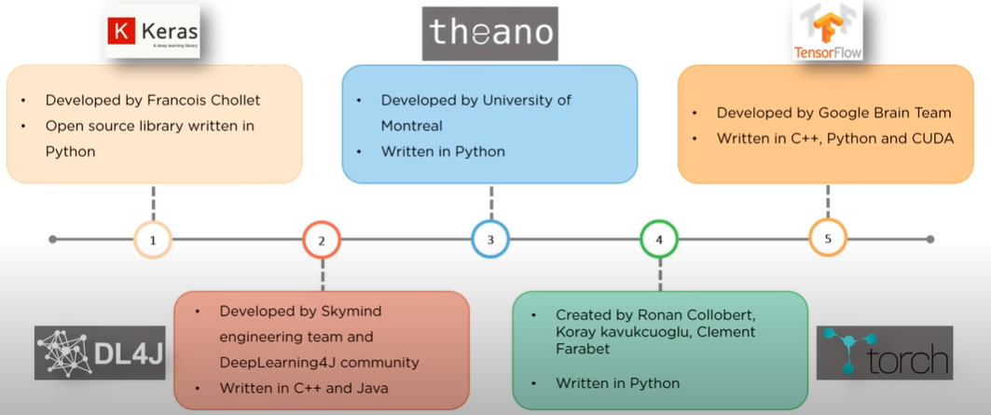
Tensor Flow
Used as a programming model in the deep learning applications

Slide 54
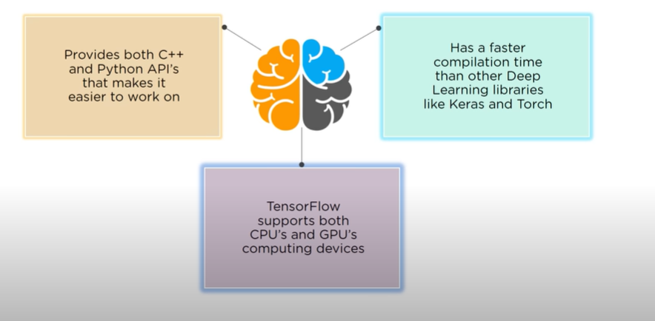
Why Tensor Flow?

Slide 55
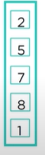
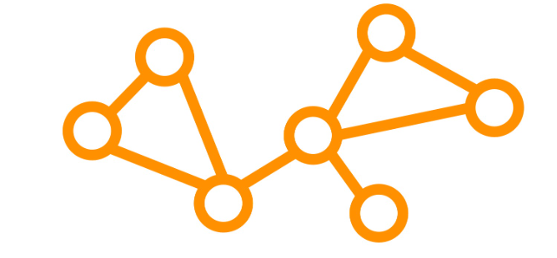
What is Tensor Flow?
Tensor Flow is an open source library developed by Google.
Developed originally to run large numerical computations.
Accepts data in the form of multi-dimensional arrays of higher dimensions called Tensors.
Works on the basis of Data Flow graphs that have nodes and edges

Slide 56
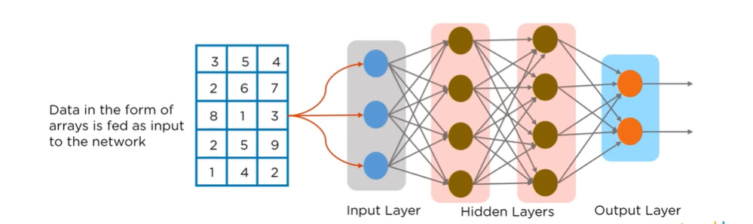
What are Tensors?
Tensor is a generalization of vectors and matrices of potentially higher dimensions.
Arrays of data of different dimensions and ranks that are fed as input to the neural network are called Tensors.

Slide 57
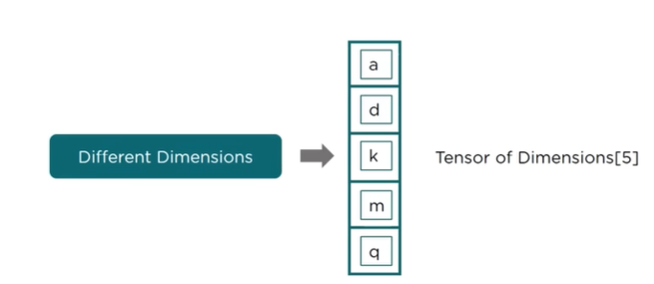



Tensor Dimensions and Ranks

Slide 58
Data Flow Graph
Each computation in tensor Flow is represented as a data flow graph
Each node in the graph represents a mathematical operation (add, subtract, multiply etc) and each edge represents multi-dimensional arrays (Tensors)
Computational graph is the graph of programming logic which Tensor Flow builds in the memory
Enables creating large scale neural networks as computing can be distributed across several CPU’s or GPU’s

Slide 59

Program Elements in Tensor Flow

Slide 60



Program Elements in Tensor Flow

Slide 61

Program Elements in Tensor Flow

Slide 62


Tensor Flow basic programs

Slide 63

Use case implementation using Tensor Flow
https://github.com/nlintz/TensorFlow-tutorials/

Slide 64
Intercloud
The concept of connected cloud networks including public, private, and hybrid clouds.
It improves the interoperability and portability among the cloud networks.
It is used to connect different cloud computing platforms and allows the data and application to be ported between data centers as cloud services.
The main focus is an direct interoperability between public cloud service providers.

Slide 65

Intercloud Architecture
Centralised intercloud federation
Peer-to-peer intercloud federation
Multi-cloud services

Slide 66

Intercloud Resource Management
These services are built to perform resource-discovery, match, schedule, select, negotiate, and monitor operations.

Slide 67

Intercloud Security
Intercloud security involves protecting data and applications that are distributed across multiple cloud environments.
It ensures the confidentiality, integrity, and availability of information as it moves between different cloud platforms

Slide 68
Intercloud Billing
Intercloud billing can be complex due to the diverse nature of cloud services and providers involved.
Parameters involved in intercloud billing :
Resource usage measurement
Metering
Pricing models
Cross cloud transactions
Aggregation and conversion
Billing statements
Challenges and considerations
Third-party tools

Slide 69
Mobile Cloud Computing (MCC)
Motivation:
Growth in use of smart phone, apps
Increased capability of mobile devices
Access of Internet using mobile devices rather than PCs!
Resource challenges (battery life, storage, bandwidth) in mobile devices?
Cloud computing offers advantages to users by allowing them to use infrastructure, platforms and software by cloud providers at low cost and elastically in an on-demand fashion.

Slide 70
Mobile backend-as-a-service
What | Provides mobile application developer a way to connect their application to backend cloud storage and processing
Why | Abstract away complexities of launching and managing own infrastructure Focus more on frontend development instead of backend functions
When | Multiple Apps, multiple backends, multiple developers Multiple mobile platforms, multiple mobile integration, multiple third-party systems and tools
How | Meaningful resources for app development accelerations- 3rd party API, Device SDK’s, enterprise connectors, social integration, cloud storage

Slide 71
Augmenting Mobile with Cloud computing
Amazon Silk browser
Split browser
Apple Siri
Speech recognition in cloud
Apple iCloud
Unlimited storage and sync capabilities
Image recognition apps on smart phones useful in developing augmented reality apps on mobile devices
Augmented reality apps using Google Glass

Slide 72
What is Mobile Cloud Computing?
Mobile Cloud Computing (MCC) is the combination of cloud computing, mobile computing, and wireless networks to bring rich computational resources to mobile users.
MCC provides mobile users with data storage and processing services in cloud
Obviating the need to have a powerful device configuration(e.g., CPU speed, memory capacity etc.)
All resource-intensive computing can be performed in the cloud
Moving computing power and data storage away from the mobile devices
Powerful and centralised computing platforms located in cloud
Accessed over the wireless connection based on a thin native client

Slide 73
Why MCC?
Speed and Flexibility
Mobile cloud applications can be built or revised quickly using cloud services. They can be delivered to many different devices with different operating systems.
Shared Resources
Mobile apps that run on the cloud are not constrained by a device’s storage and processing resources. Data intensive processes can run in the cloud. User engagement can continue seamlessly from one device to another.
Integrated Data
Mobile cloud computing enables users to quickly and securely collect and integrate data from various sources, regardless of where it resides.

Slide 74
Key features of MCC
MCC delivers applications to mobile devices quickly and securely, with capabilities beyond those of local resources.
Facilitates the quick development, delivery, and management of mobile apps.
Uses fewer device resources because applications are cloud supported.
Supports a variety of development approaches and devices.
Mobile devices connect to services delivered through and API architecture.
Improves reliability with information backed up and stored in the cloud.

Slide 75

Mobile Cloud Computing
Mobile cloud computing is a framework to augment a resource constrained mobile device to execute parts of the program on cloud based servers
Pros | Cons
Saves battery power | Must send the program states (data) to the cloud servers, hence consumes battery
Makes execution faster | Network latency can lead to execution delay

Slide 76

Typical MCC Workflow

Slide 77
MCC key components
Profiler
Monitors application execution to collect data about the time to execute, power consumption, network traffic
Solver
Solver has the task of selecting which parts of an app runs on mobile and cloud
Synchronizer
Tasks of synchronizer modules is to collect results of split execution and combine, and make the execution details transparent to the user
Simple APIs offering access to mobile services and requiring no specific knowledge of underlying network technologies
Web Interface
Internet access to remotely stored applications in the cloud

Slide 78

MCC- Typical Architecture

Slide 79
Types of Cloud Resources in MCC
Distant mobile cloud
Distant immobile cloud
Proximate mobile entity
Hybrid

Slide 80
Advantages of MCC
Extending battery lifetime
Improving data storage capacity and processing power
Improve reliability and availability
Dynamic provisioning
Scalability
Multi-tenancy
Ease of integration

Slide 81
MCC Challenges
Security Issues
Protecting user privacy and data/application secrecy from adversaries is the key to establish and maintain consumer’s trust in the mobile platform, especially in MCC.
MCC security issues have two main categories
Security for mobile users
Securing data on clouds

Slide 82
MCC Challenges
Security and Privacy for Mobile Users
Mobile devices are exposed to numerous security threats like malicious codes and their vulnerability
GPS can cause privacy issues for subscribers
Security for mobile applications:
Installing and running security software are the simplest ways to detect security threats
Mobile devices are resource constrained, protecting them from the threats is more difficult than that for resourceful devices.
Location based services (LBS) faces a privacy issue on mobile users’ provide privacy information such as their current location
Problem becomes even worse, if an adversary knows user’s important information

Slide 83
MCC Challenges
Security for Mobile Users
Approaches to move the threat detection capabilities to the cloud
Host agent runs on mobile devices to inspect the file activity on a system. If an identified file is not available in a cache of previously analyzed files, the file will be sent to the cloud network service for verification.
Attack detection for a smart phone is performed on a remote server in the cloud.
The smart phone records only a minimal execution trace, and transmits it to the security server in the cloud.

Slide 84
MCC Challenges
Network Access Management
Quality of Service
Pricing
Context-aware Mobile Cloud services
Standard Interface
Service Convergence

Slide 85
MCC Applications
M-Commerce (B2B, B2C, C2C, D2C, D2D)
Mobile learning
Mobile healthcare
Mobile gaming
And a lot more…..

Slide 86
Edge Computing
Edge computing allows the cloud to be genuinely distributed.
Don’t need to rely on the cloud for all the processing and data aggregation collection processing and querying.
Mimics the public cloud platform capabilities.
Reduces the latency by avoiding the round-trip and brings in the data sovereignty by keeping data where it actually belongs.
Delivers local storage, compute and network services.

Slide 87

Edge computing: makes distributed cloud
The previous generation of cloud was a client-server architecture where a very little processing was done in the client side but all the heavy lifting was done in the cloud.
With all the innovations done in the hardware chips, it brings more sense to bring the compute down to the devices.

Slide 88

Edge computing: mimics the public cloud platform capabilities, reduces the latency

Slide 89
Edge computing building blocks
Data ingestion
M2M brokers
Object storage
Function as a service
NoSQL/Time-series database
Stream processing
ML models

Slide 90

Data Ingestion
It is the process of obtaining and importing data for the immediate use or storage in a database. Data can be streamed in real-time or ingested in batches. In real-time data ingestion, each data item is imported as the source emits it.

Slide 91

Machine to Machine (M2M) Brokers
Edge will also run message brokers that will orchestrate machine to machine communications. Ex: device one talks to device two via the M2M brokers.

Slide 92

Storage
Object Storage-> anything that is unstructured will go into object storage, particularly to store the feed from video cameras and mics.
NoSQL/Time-series Database-> More structured data go into NoSQL and time-series database.

Slide 93

Stream Processing
It is a complex event processing engine that is enabling you to perform real-time queries and process the data as it comes. Ex: convert Farenheit to Celsius or convert one time stamp to another.

Slide 94

Function as a Service
Function as a service is actually responsible for running light-weight computation. All the sophisticated coding is done in the function as a service paradigm.

Slide 95

ML Models
There is an ML run time, for example; most of the computing platforms are capable of running TensorFlow light, pitorch models, Cafe models, so you can actually process the data that comes in more intelligently and take preventive measures and perform predictive analytics.

Slide 96

Edge Computing Architecture

Slide 97
Data Source Tier
These are nothing but original end point from where the data is acquired or the origin of the data.
In industrial IoT environment, this could be a set of devices that are generating the data.

Slide 98
Intelligence Tier
Responsible for running the machine running models.
This intelligent tier cuts across the cloud and the edge, so there is a very well-defined boundary between edge and cloud where the training takes place on the cloud and the inferencing is run on the edge. But, collectively this overlap between the cloud and the edge is the intelligence layer.

Slide 99
Actionable Inside Tier
Responsible for sending an alert to the relevant stake holders or populating the dashboards and showing some visualizations or even the edge taking an action to immediately shutdown a faulty machine or controlling an actuator and again the actionable insight takes place on the edge so this is not a physical boundary.

Slide 100
Fog Computing
Challenges of cloud computing:
Processing of huge data in a datacenter.
Datacenter may be privately hosted by the organization (private cloud set up) or publicly available by paying rent (public cloud).
All the necessary information has to be uploaded to the cloud for processing and extracting knowledge from it.
Issues with cloud-only computing:
Communication takes a long time due to human-smart phone interaction.
Datacenters are centralized, so all the data from different regions can cause congestion in the core network.
Such a task requires very low response time, to prevent further crashes or traffic jam.

Slide 101
Fog computing is known as fogging computing, it is a model in which data processing and applications are concentrated in devices at the network edge rather than existing almost entirely in the cloud.
The term “Fog computing” was introduced by the cisco systems as new model to ease wireless data transfer to distributed services in the Internet of things (IoT) paradigm.
Cisco’s vision of fog computing is to enable applications on billion of connected devices to run directly at the network edge.
Users can develop, run, manage network applications on cisco framework of networked devices, including hardened routers and switches.
Cisco brings the open source Linux and network operating system together in a single networked device.

Slide 102
Bringing intelligence down from the cloud close to the ground/end-user.
Cellular base stations, network routers, Wi-fi gateways will be capable of running applications.
End devices like sensors are able to perform basic data processing.
Processing close to devices lowers response time, enabling real- time applications.
It enables some of transactions and resources at the edge of the cloud, rather than establishing channels for cloud storage and utilization.
It reduces the need for bandwidth by not sending every bit of information over cloud channels, and instead aggregating it at certain access points.
These kind of distributed strategy, may help in lowering cost and improve efficiencies.

Slide 103

Motivation
Fog computing is a paradigm that extends cloud and its services to the edge of the network.
Fog provides data, compute, storage, and application services to the end users.
Recent advances: smart grid, smart traffic lights, connected vehicles, software-defined network.

Slide 104
Fog Computing Enablers
Virtualization: Virtual machines can be used in edge devices.
Containers: Reduces the overhead of resource management by using light-weight virtualizations. Example: Docker containers.
Service Oriented Architecture: Service-oriented architecture (SOA) is a style of software design where services are provided to the other components like application components, through a communication protocol over a network.
Software-defined Networking: Software-defined Networking (SDN) is an approach to use open protocols such as OpenFlow, to apply globally aware software control at the edges of the network to access network switches and routers that typically would use closed and proprietary firmware.

Slide 105
Fog Computing- not a replacement of Cloud Computing
Fog/edge devices are there to help the cloud data center to better response time for real-time applications. Handshaking among fog and cloud computing are needed.
Broadly, benefits of fog computing are:
Low latency and location awareness
Widespread geographical distribution
Mobility
Very large number of nodes
Predominant role of wireless access
Strong presence of streaming and real-time applications
Hetereogeneity

Slide 106
Fog advantages
Fog can be distinguished from cloud by its proximity to end users.
Dense geographical distribution and its support for mobility
It provides low latency, location-awareness, and improves quality-of-service (QoS) and real-time applications.

Slide 107
Fog Computing and Cloud Computing
Requirement | Cloud Computing | Fog Computing
Latency | High | Low
Delay jitter | High | Very low
Location of server nodes | Within Internet | At the edge of local network
Distance between the client and server | Multiple hops | One hop
Security | Undefined | Can be defined
Attack on data encounter | High probability | Very less probability
Location awareness | No | Yes
No. of server nodes | Few | Very large
Geographical distribution | Centralized | Distributed
Support of mobility | Limited | Supported
Real-time interactions | Supported | Supported
Type of last mile connectivity | Leased line | Wireless

Slide 108
Fog Computing Use cases
Emergency Evacuation Systems: Real-time information about currently affected areas of building and exit route planning.
Natural Disaster Management: Real-time notification about landslides, flash floods to potentially affected areas.
Large sensor deployments generate a lot of data, which can be pre-processed, summarized, and then sent to the cloud to reduce congestion in the network.
Internet of Things (IoT) based big data applications: Connected vehicles, smart cities, wireless sensor and actuator networks (WSAN) etc.

Slide 109
Applicability
Smart traffic lights
Connected vehicles
Smart grids
Wireless sensors
Internet of Things
Software-defined network

Slide 110

Fog computing in smart traffic lights and connected vehicles

Slide 111

Fog computing and IoT

Slide 112

Fog computing and Smart grids

Slide 113
Fog Challenges
Fog computing systems suffer from the issue of proper resource allocation among the applications while ensuring the end-to-end latency of the services.
Resource management of the fog computing network has to be addressed so that the system throughput increases ensuring high availability as well as scalability.
Security of applications/services/data.

Slide 114
Resource Management of Fog Network
Utilization of idle fog nodes for better throughput.
More parallel operations.
Handling load balancing.
Meeting the delay requirements of real-time applications.
Provisioning crash fault tolerance.
More scalable system.

Slide 115
Resource Management- Challenges
Data may not be available at the executing fog node. Therefore, data fetching is needed from the required sensor or data source.
The executive node might become unresponsive due to heavy workload, which comprises the latency.
Choosing a new node in case of micro service execution migration, so that the response time gets reduced.
Due to unavailability of an executing node, there is a need to migrate the partially processed persistent data to a new node (state migration).
Final result has to be transferred to the client or actuator within very less amount of time.
Deploying application components in different fog computing nodes ensuring latency requirement of the components.
Multiple applications may collocate in the same fog node. Therefore, the data of one application may get compromised by another application. Data security and integrity of individual applications by resource isolation has to be ensured.

Slide 116
Resource Management- Approaches
Execution migration to the nearest node from the mobile client.
Minimizing the carbon footprint for video printing service in fog computing.
Emphasis on resource prediction, resource estimation and reservation, advance reservation as well as pricing for new and existing IoT customers.
Docker as an edge computing platform. Docker may facilitate fast deployment, elasticity, and good performance over virtual machine based edge computing platform.
Resource management based on the fluctuating relinquish probability of the customers, service price, service type, and variance of the relinquish probability.

Slide 117
Security issues
Major security issues are authentication at different levels of gateways as well as in fog nodes.
Man-in-the-middle attack
Privacy issues
In case of the smart grids, the smart meters installed in the consumer’s homes. Each smart meter and smart appliance has an IP address. A malicious user can either tamper with its own smart meter, report false readings, or spoof IP addresses.

